Slide 1

Maximizing profits for Ebay auctions using 2012 data
Jason Phennicie

Slide 2
Motivation
Objectives:
Find the price increases in 3 vs 5 vs 7 day auctions
Determine the optimal auction conditions for maximum return.

Slide 3
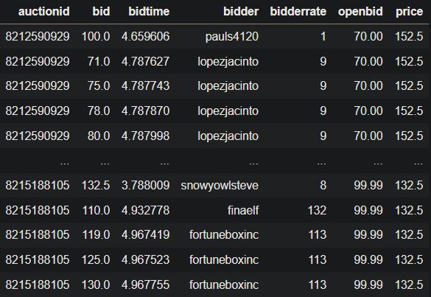
Dataset
https://www.modelingonlineauctions.com/datasets
Cartier wristwatches on eBay
Xbox game consoles on eBay
Approximately 1000 auctions
Credit to Sharad Borle, Shanshan Wang, Wolfgang Jank and Galit Shmueli for gathering and publishing these datasets.

Slide 4
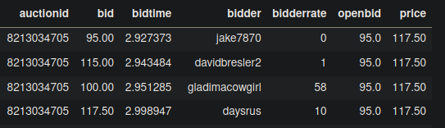
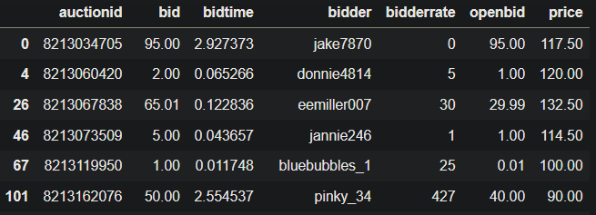
Cleaning the data
Null values in dataframe
Remove clutter

Slide 5
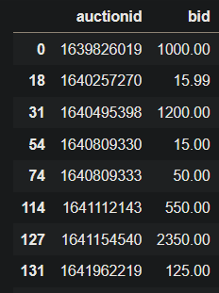
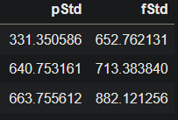
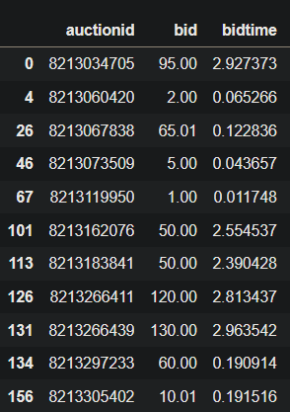
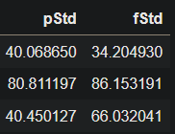
Extremely variable data
Cartier watches Xbox consoles

Slide 6
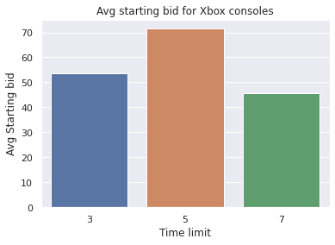
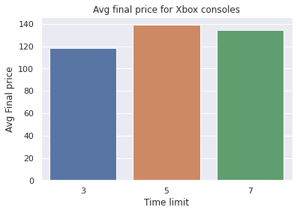
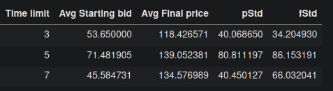
Results
Xbox consoles

Slide 7
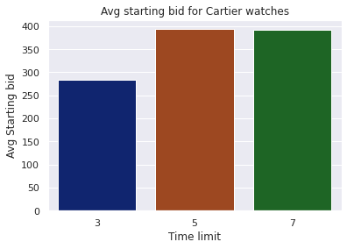
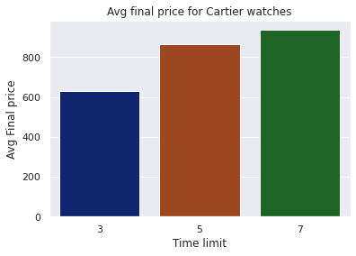
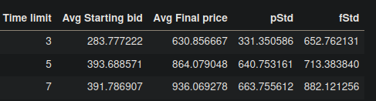
Results
Cartier watches

Slide 8
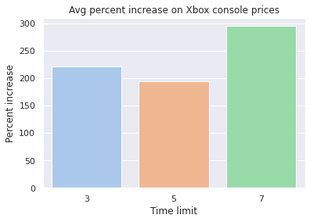
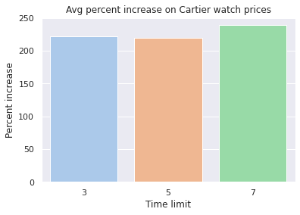
Results
Percent increase in price
3 day auction % increase:
Cartier watches - 222.30%
Xbox consoles - 220.74%
5 day auction % increase:
Cartier watches - 219.48%
Xbox consoles - 194.53%
7 day auction % increase:
Cartier watches - 238.92%
Xbox consoles - 295.22%

Slide 9
Conclusion
Optimal auction parameters for high return:
7 day list time
Higher initial price point
Xbox 7 day increase: 295.22%
Cartier watch 7 day price increase: 238.92%

Slide 10
Questions

